Slide 1
C
Arrays

Slide 2
C Header Files
<assert.h> Program assertion functions
<ctype.h> Character type functions
<locale.h> Localization functions
<math.h> Mathematics functions
<setjmp.h> Jump functions
<signal.h> Signal handling functions
<stdarg.h> Variable arguments handling functions
<stdio.h> Standard Input/Output functions
<stdlib.h> Standard Utility functions
<string.h> String handling functions
<time.h> Date time functions
Structures of related data items.
Static entity - same size.
same types of variables.
Continuous blocks in memory.
Introduction
What is an array?

Slide 3
C Header Files
<assert.h> Program assertion functions
<ctype.h> Character type functions
<locale.h> Localization functions
<math.h> Mathematics functions
<setjmp.h> Jump functions
<signal.h> Signal handling functions
<stdarg.h> Variable arguments handling functions
<stdio.h> Standard Input/Output functions
<stdlib.h> Standard Utility functions
<string.h> String handling functions
<time.h> Date time functions
Format
array_type array_name [size];
Examples
int c[ 10 ];
float hi[ 3284 ];
int b[ 100 ], x[ 27 ];
Declaring
What is an array?

Slide 4
C Header Files
<assert.h> Program assertion functions
<ctype.h> Character type functions
<locale.h> Localization functions
<math.h> Mathematics functions
<setjmp.h> Jump functions
<signal.h> Signal handling functions
<stdarg.h> Variable arguments handling functions
<stdio.h> Standard Input/Output functions
<stdlib.h> Standard Utility functions
<string.h> String handling functions
<time.h> Date time functions
Formatting
arrayname [position number]
First element at position 0
arr [0] = 3;
arr [ 5 – 2 ] == arr [ 3 ] == arr [ x ]
What is an array?

Slide 5
C Header Files
<assert.h> Program assertion functions
<ctype.h> Character type functions
<locale.h> Localization functions
<math.h> Mathematics functions
<setjmp.h> Jump functions
<signal.h> Signal handling functions
<stdarg.h> Variable arguments handling functions
<stdio.h> Standard Input/Output functions
<stdlib.h> Standard Utility functions
<string.h> String handling functions
<time.h> Date time functions
Initializers
int n[ 5 ] = { 1, 2, 3, 4, 5 };
int n[ 5 ] = { 0 }
Sets all the elements to 0
int n[] = { 1, 2, 3, 4, 5 };
What is an array?

Slide 6
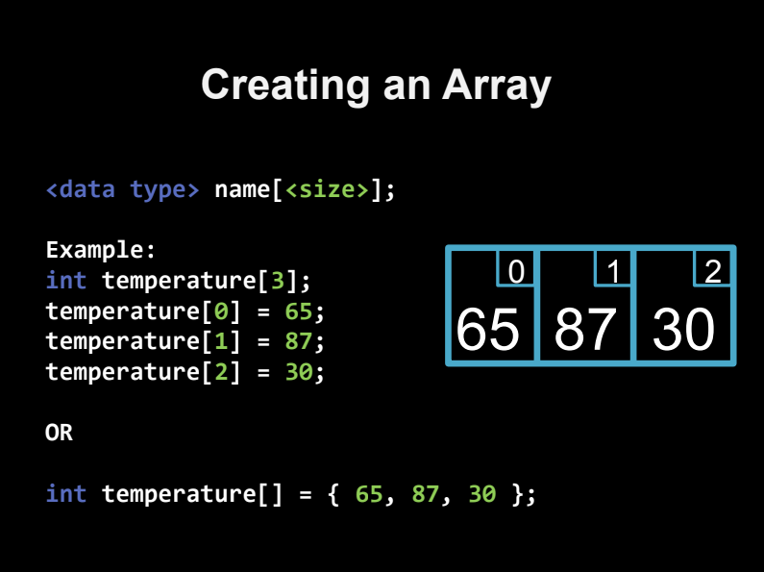

Slide 7
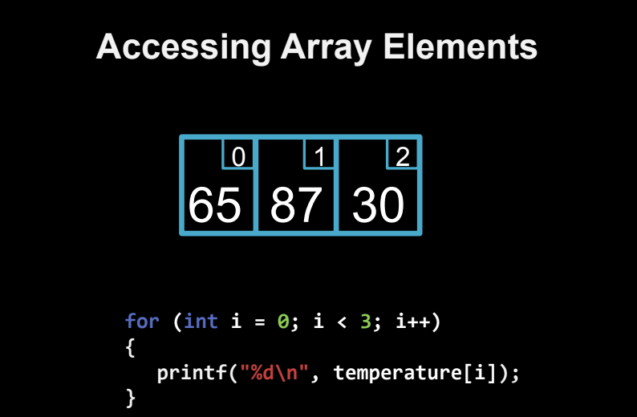

Slide 8
C Header Files
<assert.h> Program assertion functions
<ctype.h> Character type functions
<locale.h> Localization functions
<math.h> Mathematics functions
<setjmp.h> Jump functions
<signal.h> Signal handling functions
<stdarg.h> Variable arguments handling functions
<stdio.h> Standard Input/Output functions
<stdlib.h> Standard Utility functions
<string.h> String handling functions
<time.h> Date time functions
c[0]
-45
c[1]
6
c[2]
0
Shape
c[3]
72
c[4]
1543
c[5]
-89
c[6]
0
What is an array?
c[7]
62
c[8]
-3
c[9]
1
c[10]
6453
c[11]
78
Position number of the element within array c

Slide 9
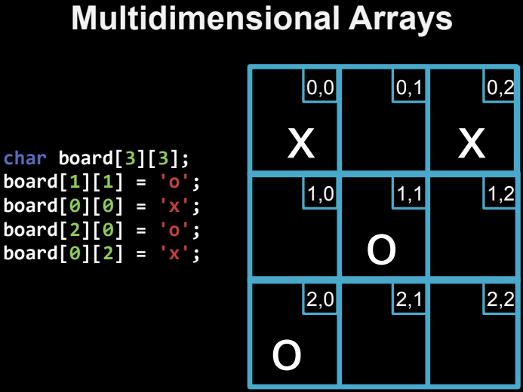

Slide 10
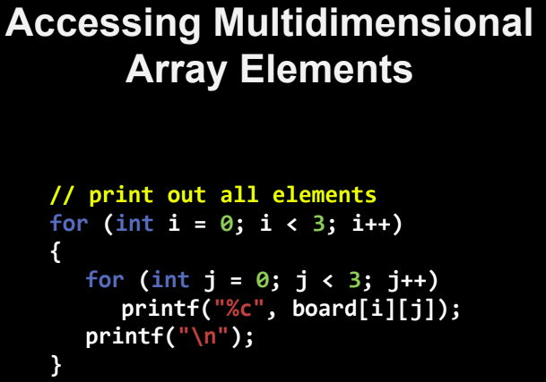

Slide 11
Functions
void getArr( int b[]);
What is an array?

Slide 12
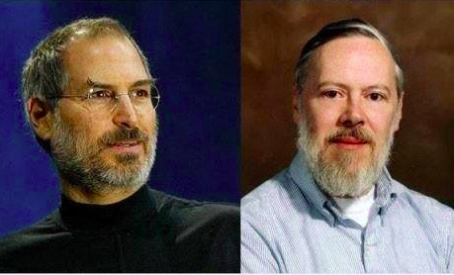

Slide 13
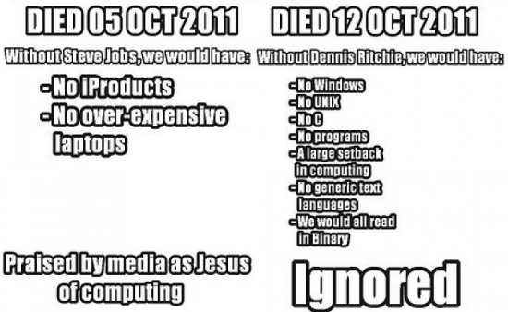

Slide 14


Slide 15
YOU CAN DO IT!
Build a simple program (in a function style) that calculates the
Average of the array.
Maximum element.
Minimum element.
Search for element in the array.
SORT THE ARRAY

